Slide 1
Model-based Integrated Planning and Control of Autonomous Vehicles using Artificial Potential Fields with uncertain environment
Emilio Benenati
Josyula Viswanath Das
12th November 2021

Slide 2
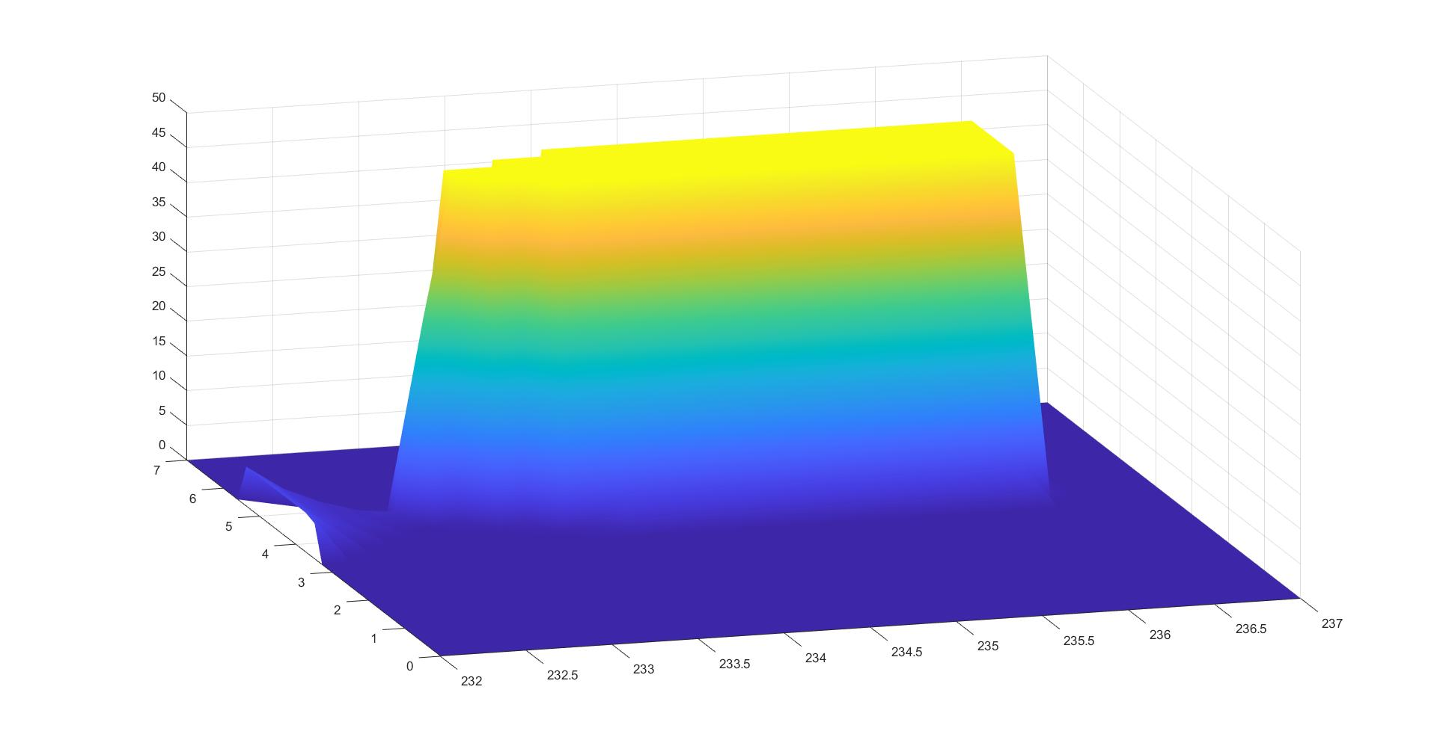

Slide 3
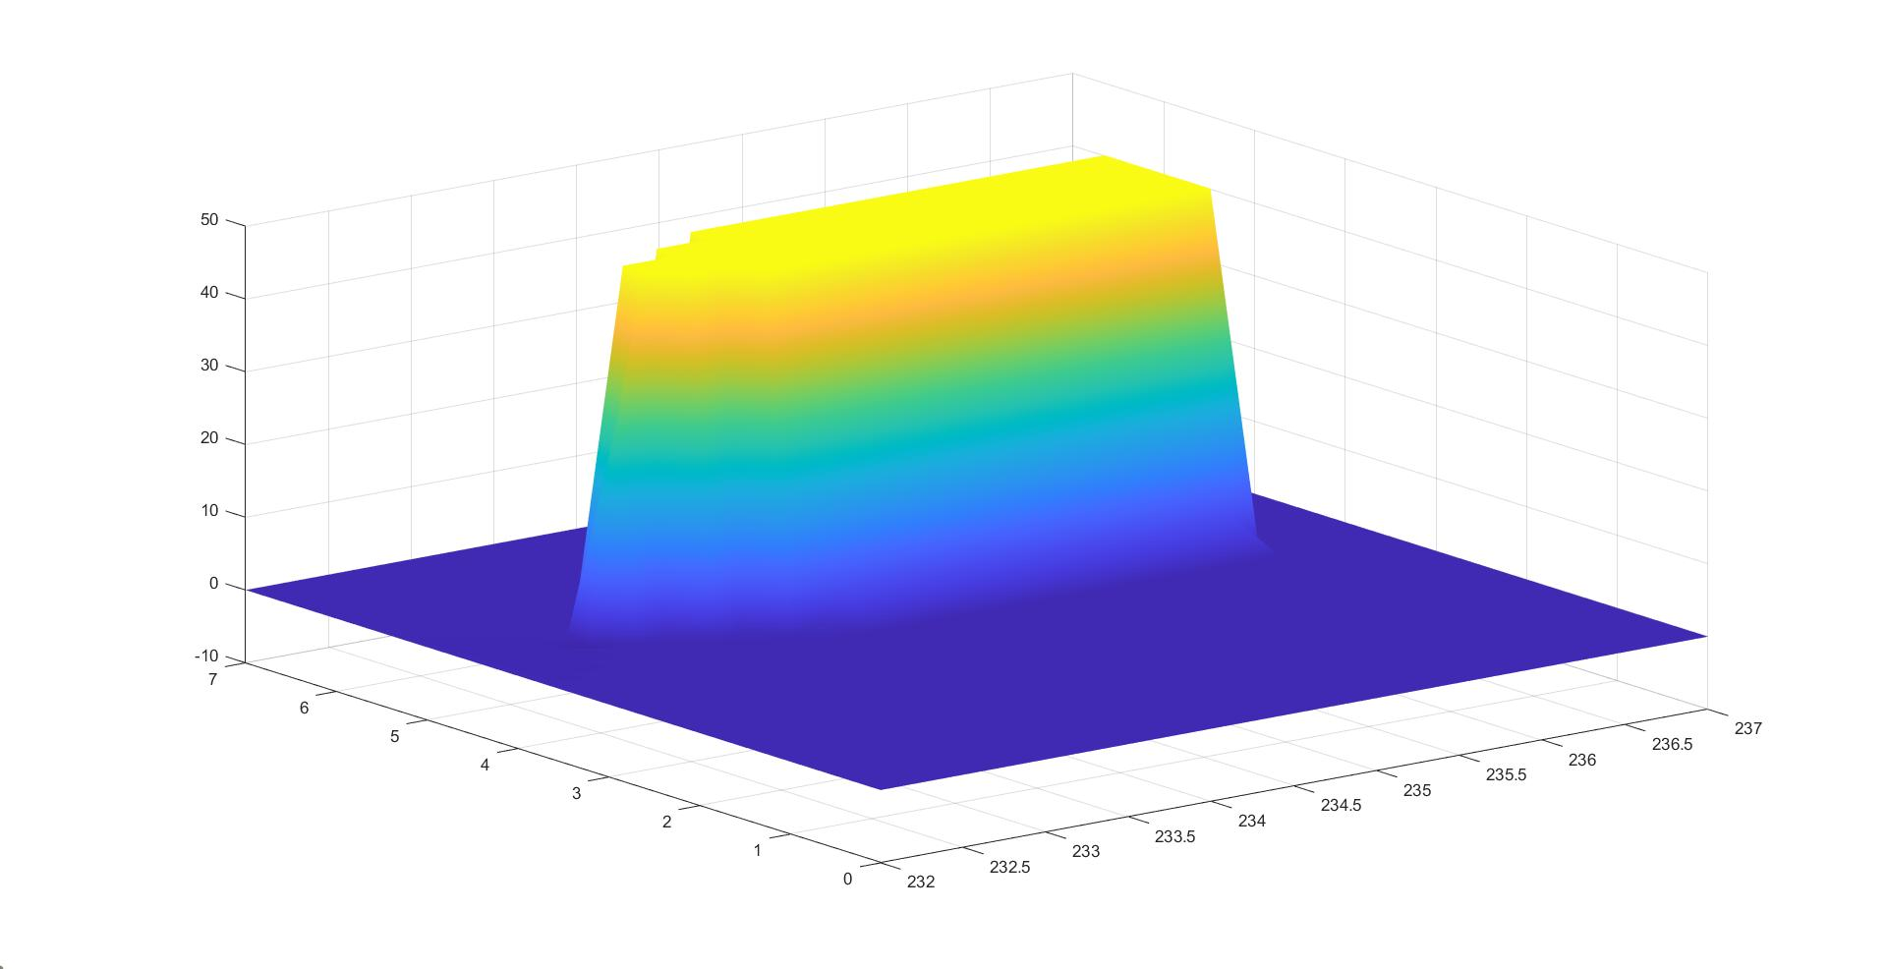

Slide 4
